Slide 1

Consumer Goods Ad Hoc Insights
Presented by – Ayush Bambure

Slide 2
Content
About Company
Company Market & Data
Ad Hoc Request , Query & Output
Visualization and Insight

Slide 3
Company Overview
Atliq Hardware, a leading computer hardware producer in India.
Global presence with expansions in multiple countries.
Company Problem
The management noticed that they do not get enough insights
To make quick and smart data-informed decisions.
About AtliQ Hardware

Slide 4
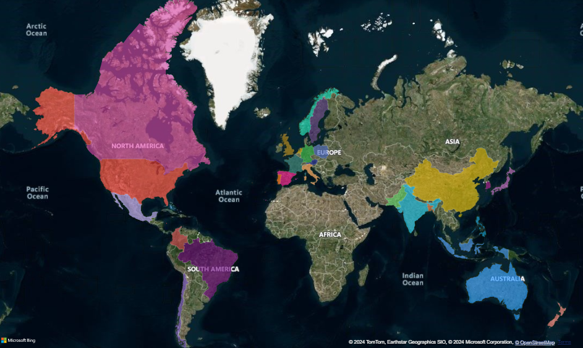
AtliQ Market

Slide 5
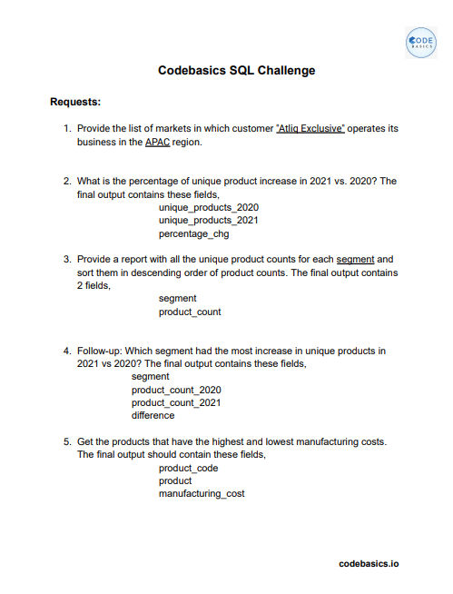
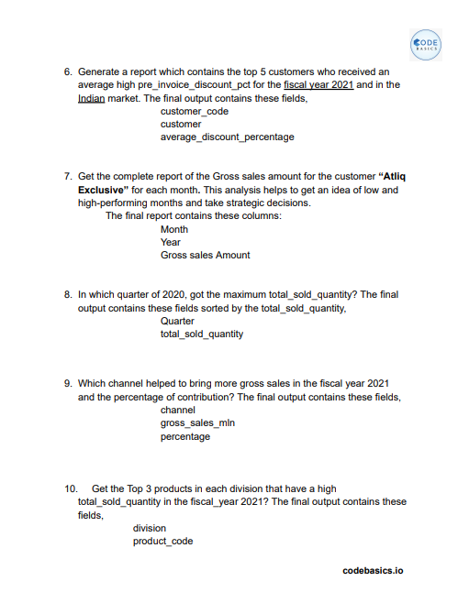
Ad Hoc Request

Slide 6
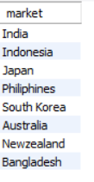
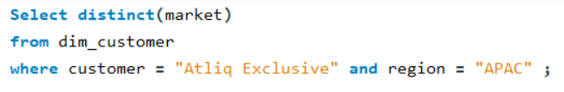
Request | Query | Output
1. Provide the list of markets in which customer "Atliq Exclusive" operates its business in the APAC region.

Slide 7
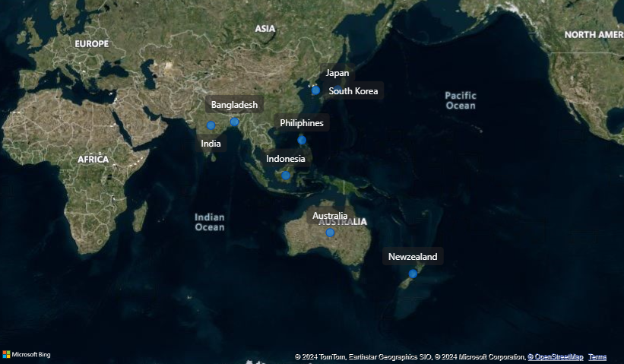
Visualization | Insights
These are the market in APAC region where Atliq Hardware sales their product.

Slide 8
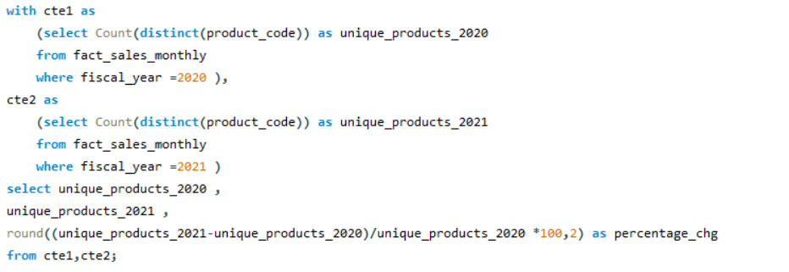

Request | Query | Output
2. What is the percentage of unique product increase in 2021 vs. 2020?

Slide 9
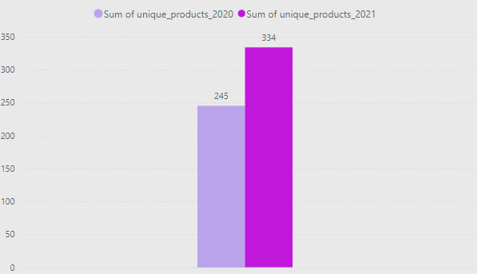
Visualization | Insights
The Product increase in 2021 is 36.33%.
Continuously Innovating with introducing new Product.

Slide 10
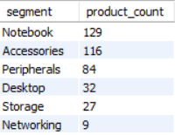
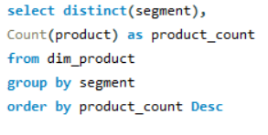
Request | Query | Output
3. Provide a report with all the unique product counts for each segment and sort them in descending order of product counts

Slide 11
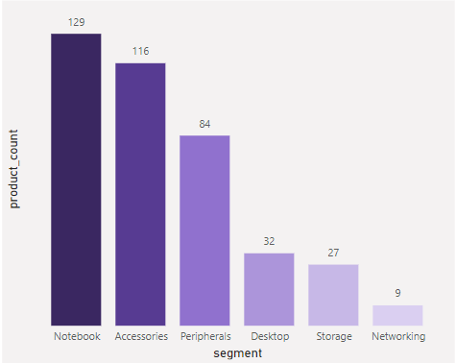
Visualization | Insights
Notebook, Accessories & Peripherals contribute around 83%
Some new product should be introduced in Networking.

Slide 12
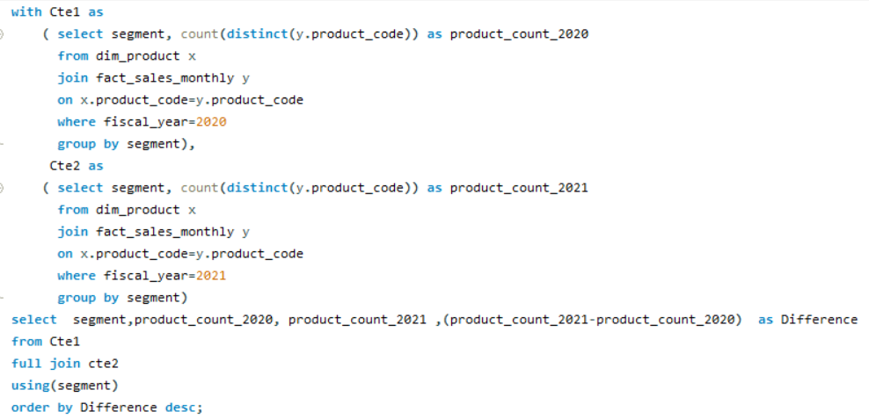
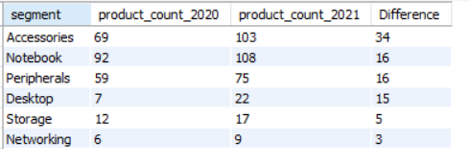
Request | Query | Output
4. Which segment had the most increase in unique products in 2021 vs 2020?

Slide 13
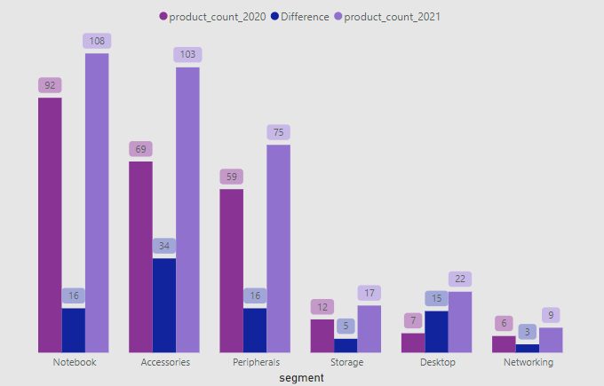
Visualization | Insights
Accessories has 34 the largest increase in production
Storage and Networking producing lowest

Slide 14
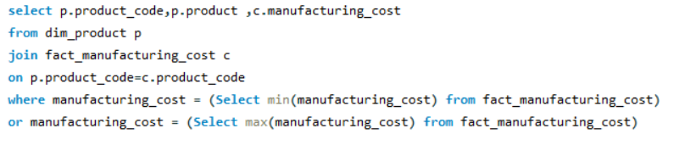

Request | Query | Output
5. Get the products that have the highest and lowest manufacturing costs

Slide 15
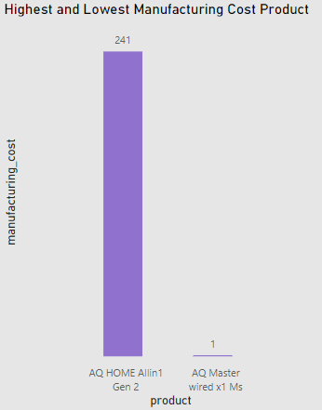
Visualization | Insights
Highest manufacturing cost of product is 241.
Lowest manufacturing cost of product is 1.

Slide 16
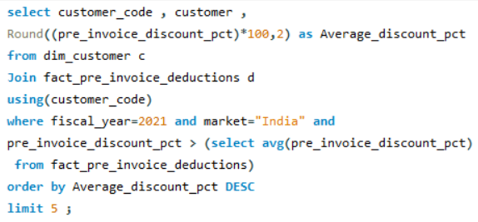
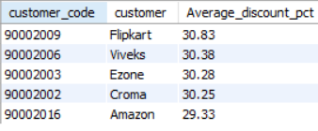
Request | Query | Output
6. Generate a report which contains the top 5 customers who received an average high pre_invoice_discount_pct for the fiscal year 2021 and in the Indian market.

Slide 17
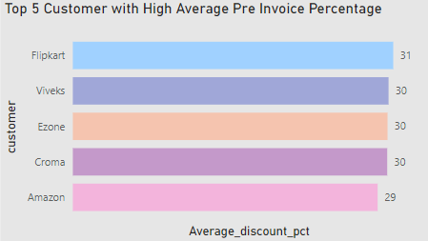
Visualization | Insights
In 2021 the average pre invoice discount given by top 5 customer is similar however Flipkart gave the highest avg discount i.e. 30.83 %.

Slide 18
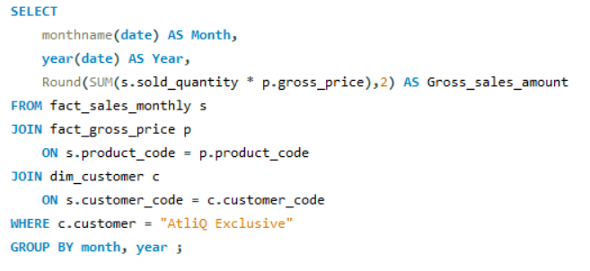
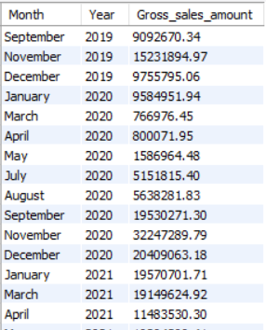
Request | Query | Output
7. Get the complete report of the Gross sales amount for the customer “Atliq Exclusive” for each month. This analysis helps to get an idea of low and high-performing months and take strategic decisions.

Slide 19
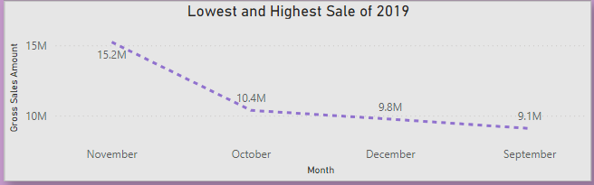
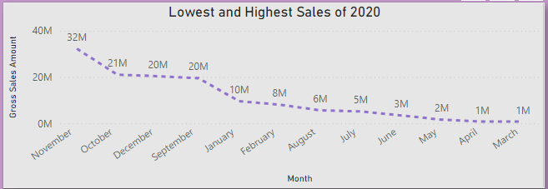
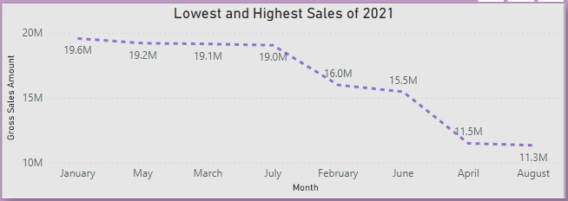
Visualization | Insights
Lowest Sales – September 2019
Highest Sales – November 2019
Lowest Sales – November 2020
Highest Sales – March 2020
Lowest Sales – January 2021
Highest Sales – August 2021

Slide 20
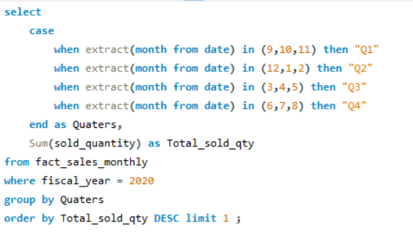

Request | Query | Output
8. In which quarter of 2020, got the maximum total_sold_quantity?

Slide 21
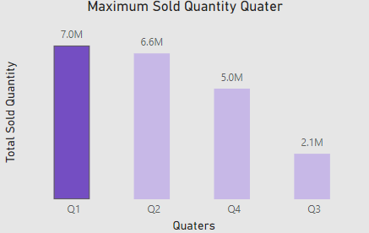
Visualization | Insights
In Quarter 1 sold maximum quantity i.e. 7 M where as Quarter 3 significantly decreased to 2.1 M, the reason behind is the Covid-Lockdown in the month of March, April & May

Slide 22
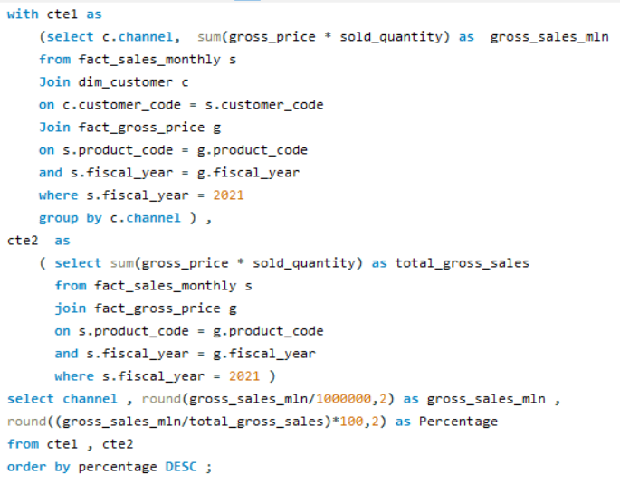
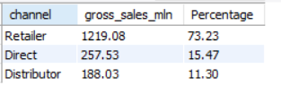
Request | Query | Output
9. Which channel helped to bring more gross sales in the fiscal year 2021 and the percentage of contribution?

Slide 23
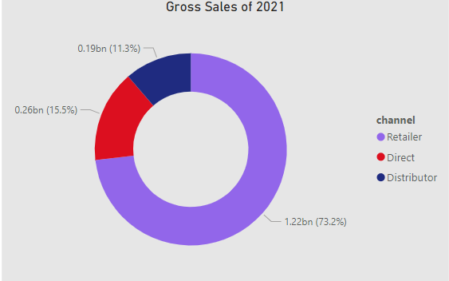
Visualization | Insights
The Retailers contribute to the major portion of the sales that is 73% where as Direct and Distributer combined sales is 27% .

Slide 24
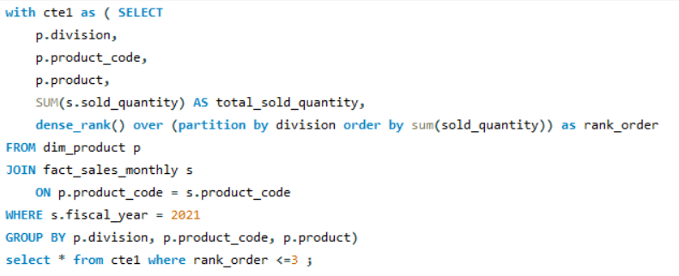
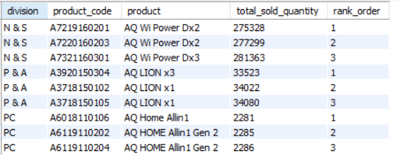
Request | Query | Output
10. Get the Top 3 products in each division that have a high total_sold_quantity in the fiscal_year 2021?

Slide 25
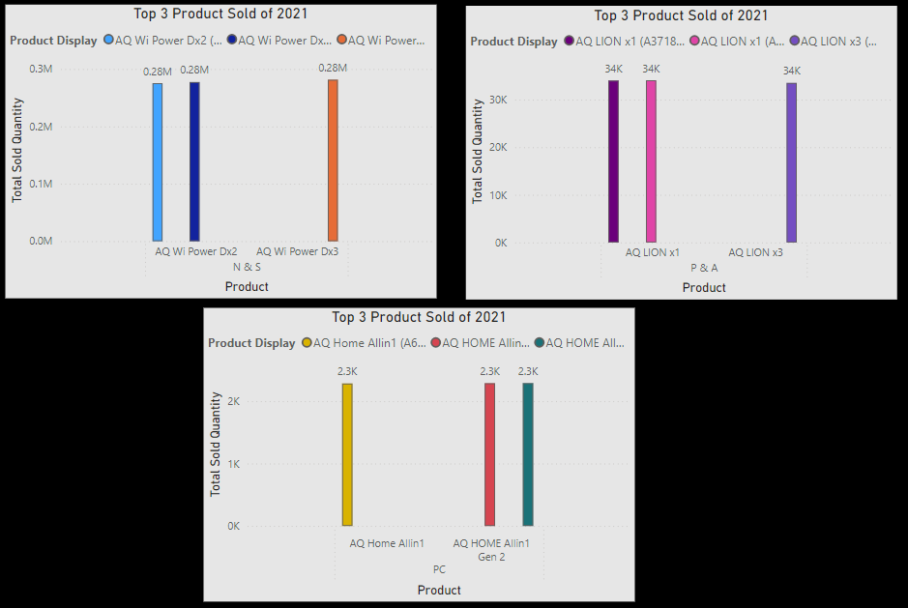
Visualization | Insights
Top 3 products in each division that have a highest total sold quantity in the fiscal year 2021

Slide 26
Thank you
Ayush Bambure
ayushbambure09@gmail.com

